Slide 1



AtliQ Hardware
Ad Hoc Analysis
Presented by Bader Nader

Slide 2
Overview
Context
03
Atliq Business Overview
06
Getting familiar with Dataset
12
Requests, Results & Insights
14

Slide 3
Context

Slide 4
Company
AtliQ Hardware, a leading electronics accessories company, embarked on an ad hoc analysis project to address a critical need for actionable insights to support strategic decision-making.
Problem Statement
The management noticed that they do not get enough insights to make quick and smart data-informed decisions. They want to expand their data analytics team by adding several junior data analysts.

Slide 5
Objective
This project aimed to address critical business inquiries by effectively extracting, querying, and analyzing relevant data, ultimately enabling informed decision-making based on the derived insights.
Approach
A systematic approach was employed, involving data import, cleaning, query development, and visualization, with a focus on delivering concise and impactful recommendations.

Slide 6
Understanding AtliQ Business

Slide 7






AtliQ’s Business Model
Customers
Consumer
AtliQ Hardware

Slide 8

Platforms
Brick & Mortar
E-Commerce

Slide 9

Channels
Retailer
Direct
Distributor
NEPTUNE
NEPTUNE
E-Store
Exclusive

Slide 10
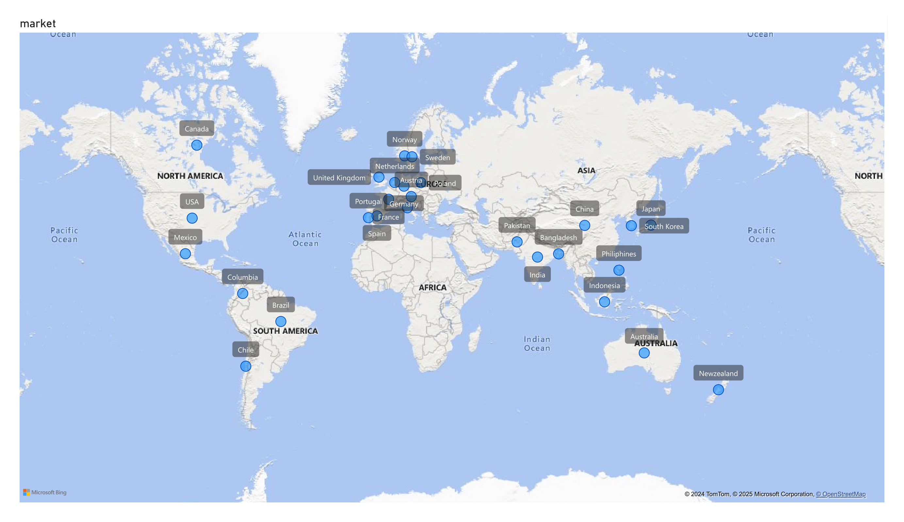
AtliQ’s Markets

Slide 11
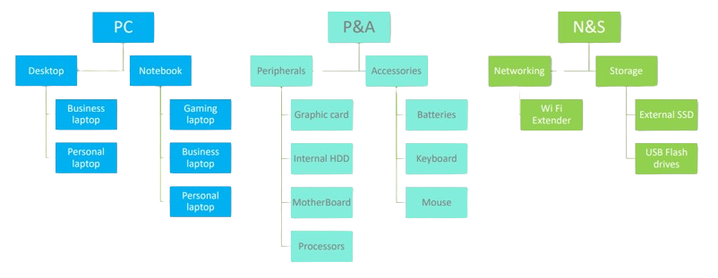
AtliQ’s Products

Slide 12
Getting familiar with the dataset

Slide 13
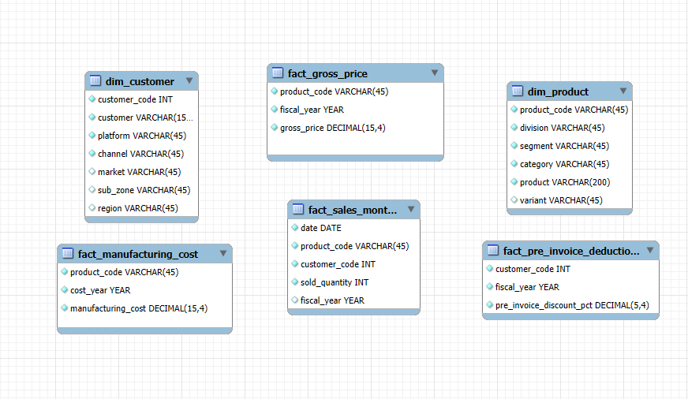
Data Model
Fiscal year for Atliq Hardware starts from 1st September and ends on 31st August each year. Sales data is available for fiscal year 2020-2021.

Slide 14
Requests, Results & Insights

Slide 15
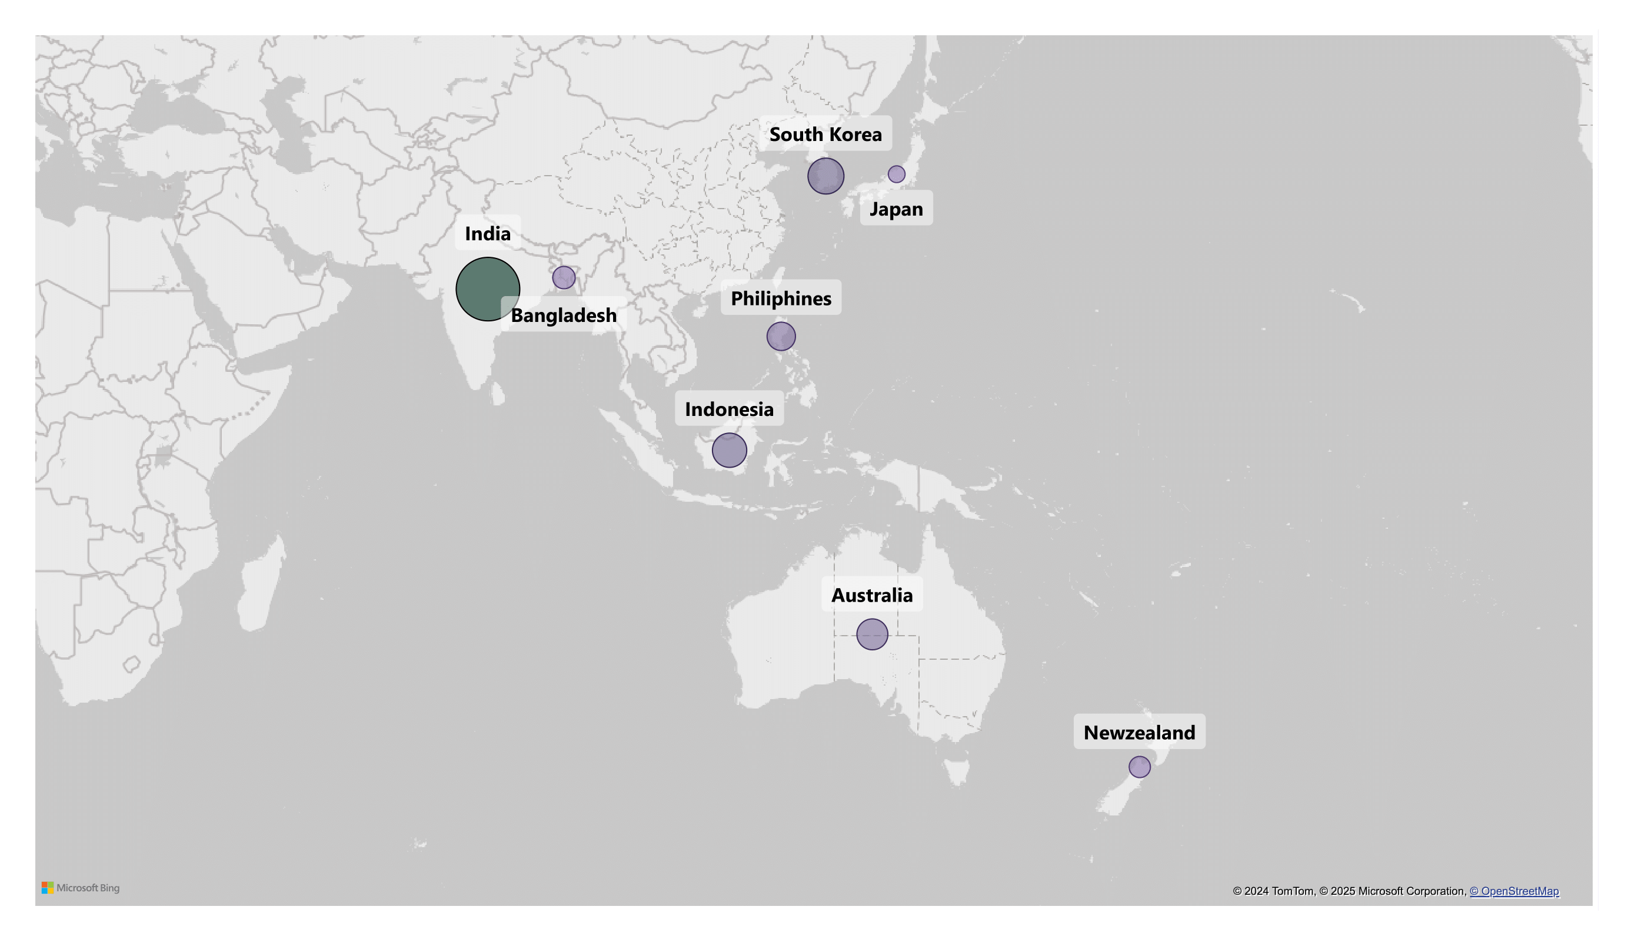
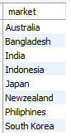
Request 1:
Provide the list of markets in which customer "AtliQ Exclusive" operates its business in the APAC region.

Slide 16
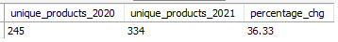
Request 2:
What is the percentage of unique product increase in 2021 vs. 2020?
The final output contains these fields,
unique_products_2020
unique_products_2021
percentage_chg

Slide 17
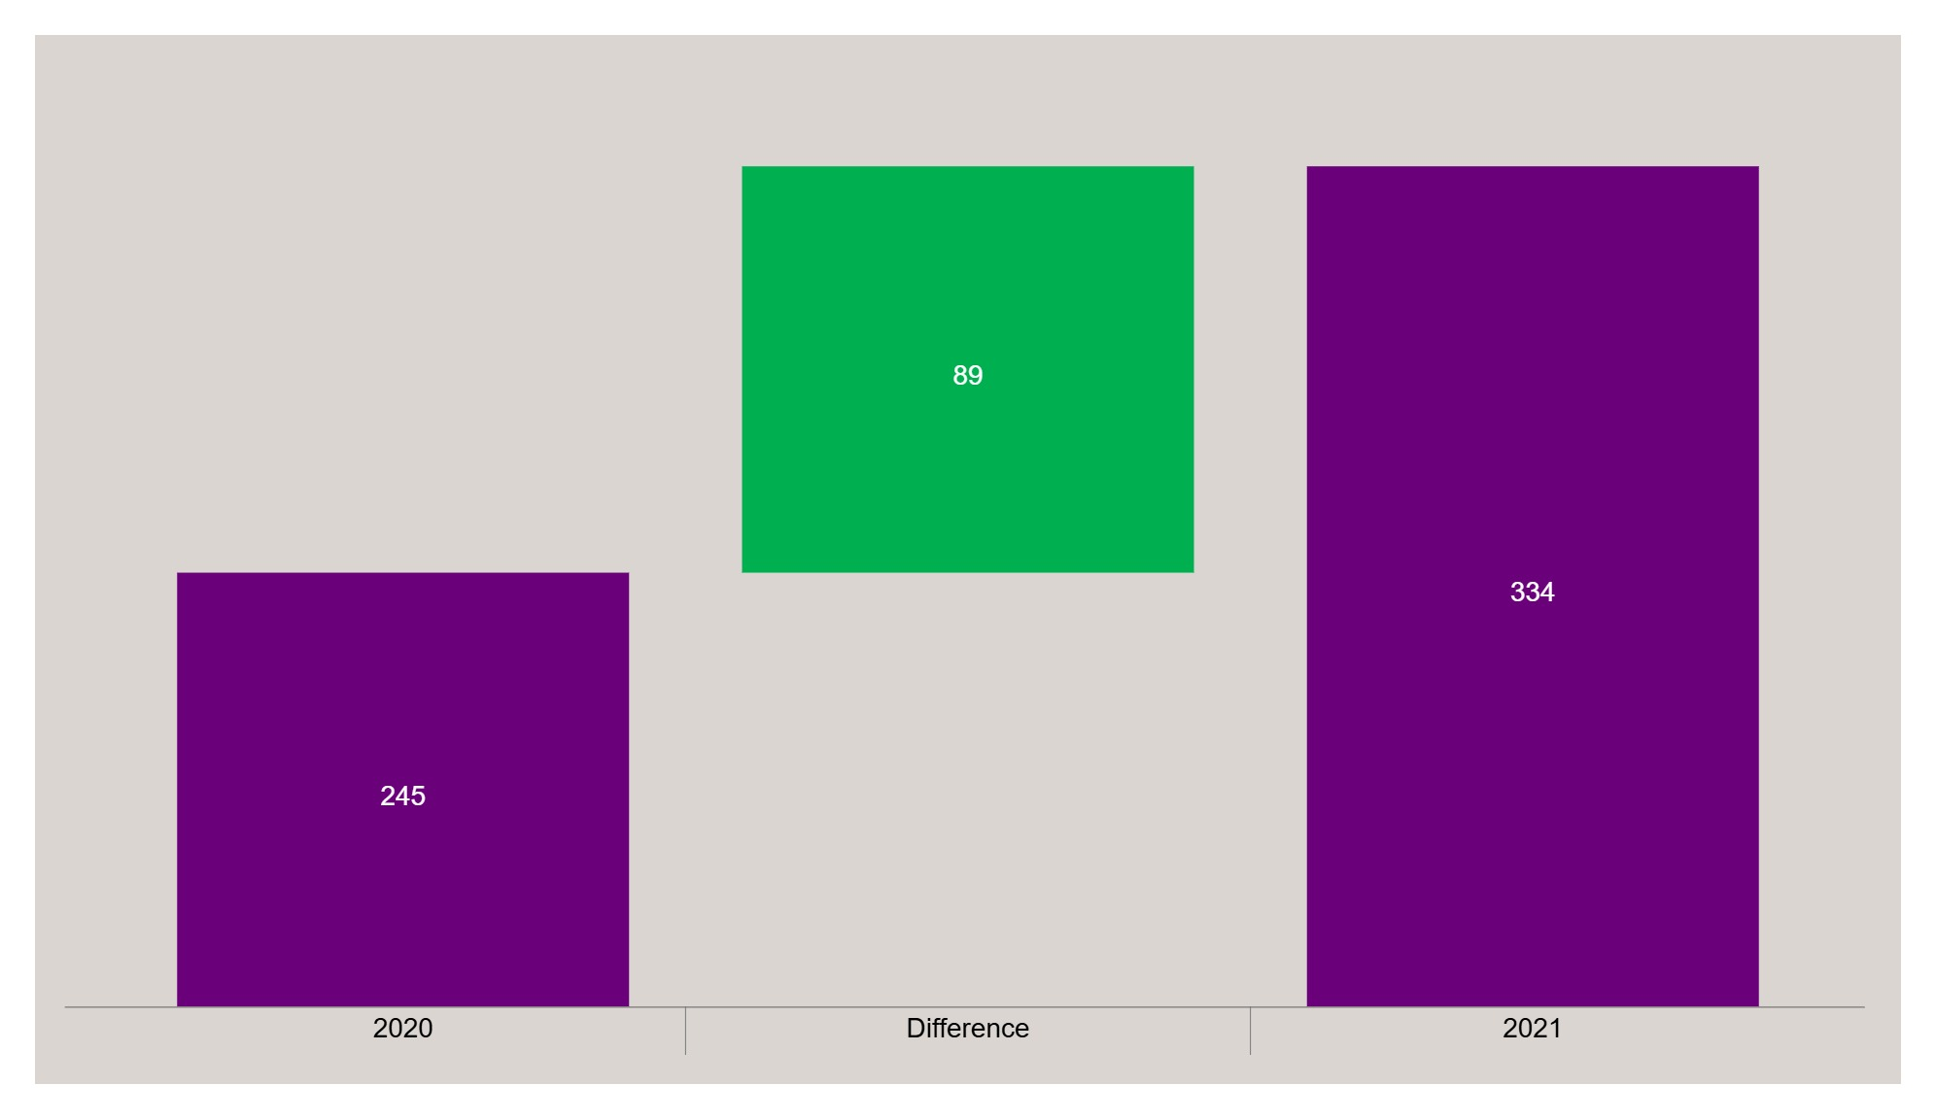
Insights
The number of different products available in 2021 was 36.33% higher than the number of different products available in 2020.
36.33% Increase

Slide 18
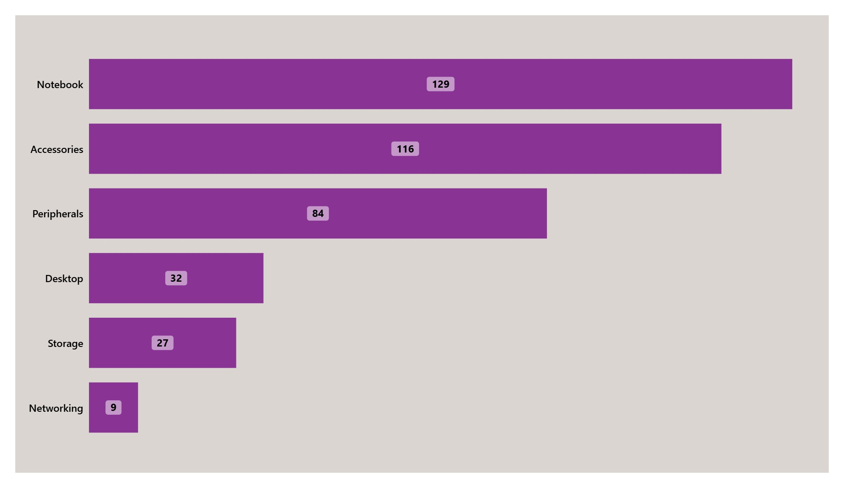
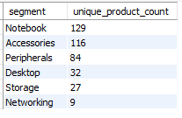
Request 3:
Provide a report with all the unique product counts for each segment and sort them in descending order of product counts. The final output contains 2 fields,
segment
product_count

Slide 19
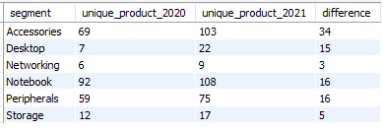
Request 4:
Which segment had the most increase in unique products in 2021 vs 2020? The final output contains these fields,
segment
product_count_2020
product_count_2021
difference

Slide 20
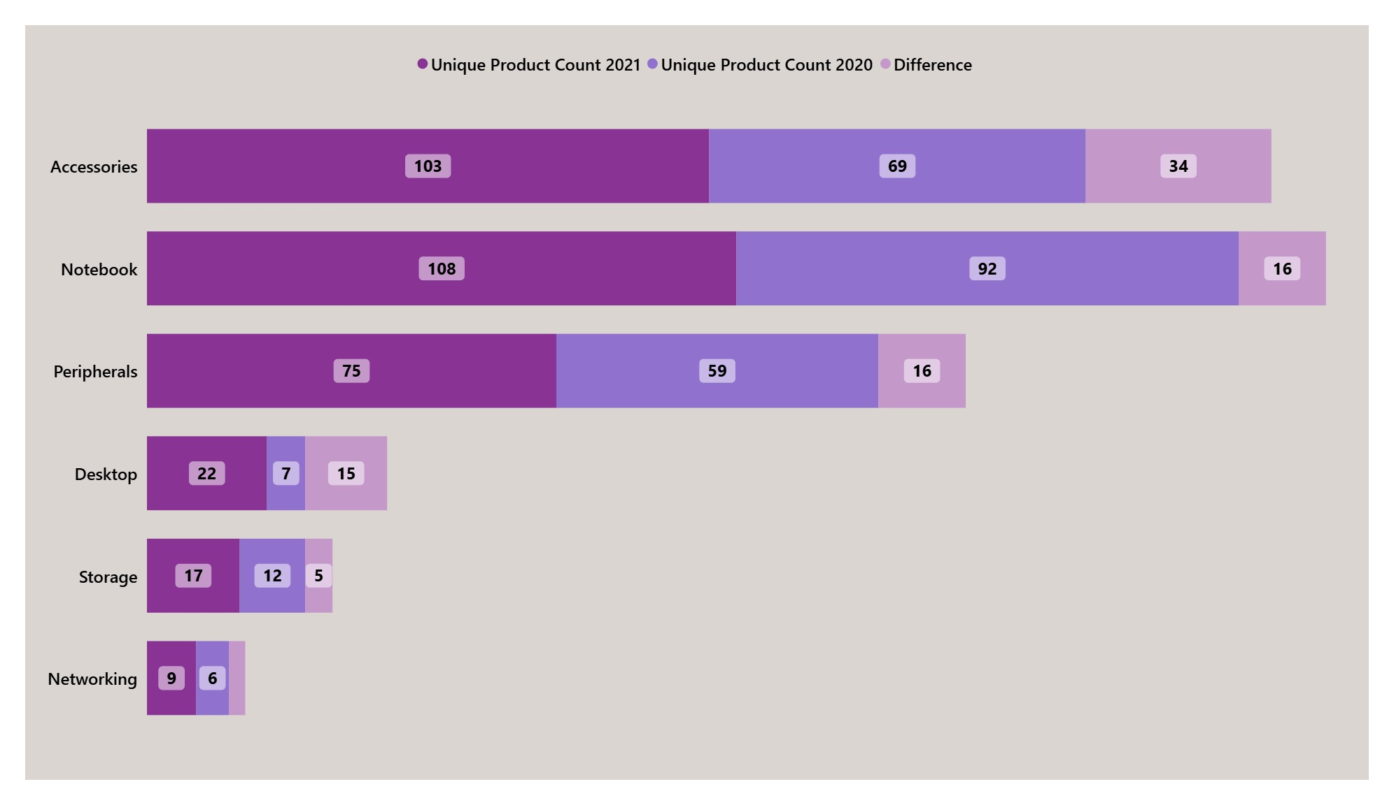
Insights
There is a general trend of an increase in the number of unique products across all categories from 2020 to 2021.

Slide 21
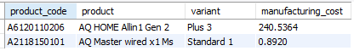
Request 5:
Get the products that have the highest and lowest manufacturing costs. The final output should contain these fields,
product_code
product
manufacturing_cost

Slide 22


Insights
The product which has highest and lowest manufacturing cost are AQ Home Allin1 Gen 2 with Rs. 240.54 and AQ Master wired x1 Ms with Rs. 0.89
manufacturing cost.
AQ HOME Allin1 Gen 2
AQ Master wired x1 Ms
Variant: Plus 3
Variant: Standard 1

Slide 23
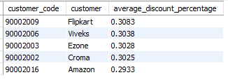
Request 6:
Generate a report which contains the top 5 customers who received an average high pre_invoice_discount_pct for the fiscal year 2021 and in the Indian market. The final output contains these fields,
customer_code
customer
average_discount_percentage

Slide 24
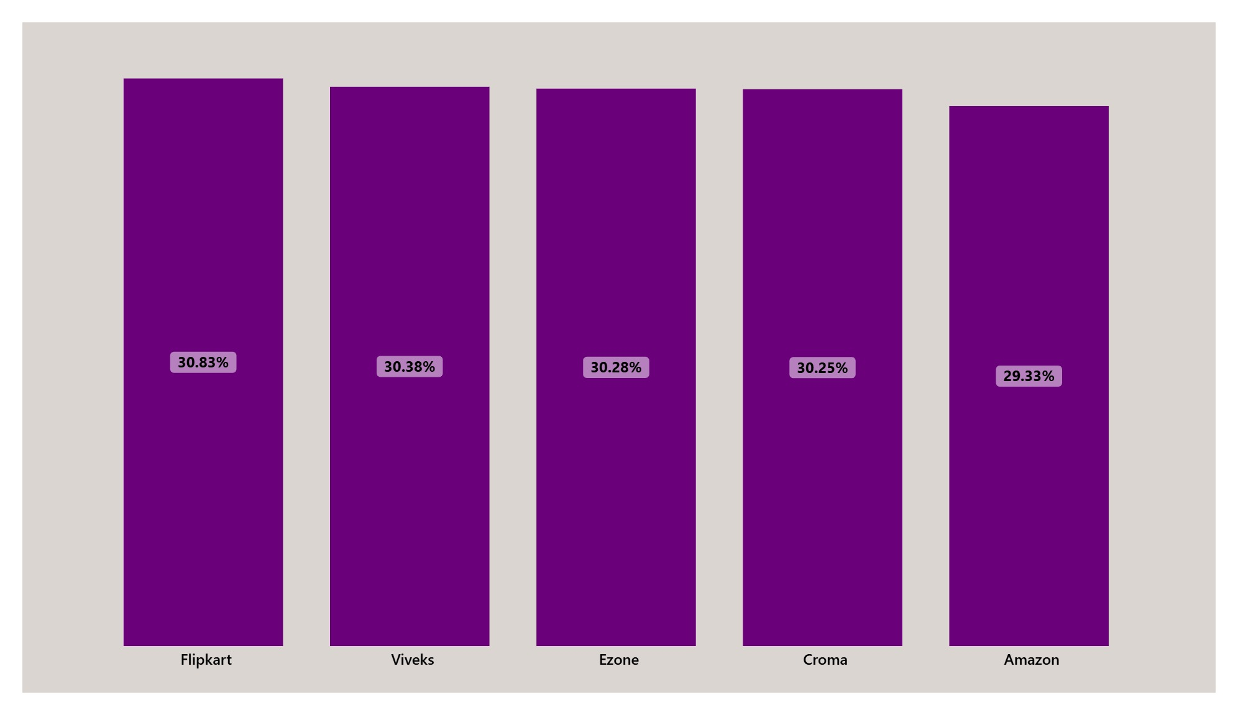
Insights
All five customers receive a relatively high average pre-invoice discount, ranging from 29.33% to 30.83%.

Slide 25
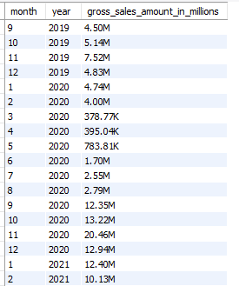
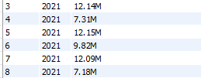
Request 7:
Get the complete report of the Gross sales amount for the customer “Atliq Exclusive” for each month. This analysis helps to get an idea of low and high-performing months and take strategic decisions. The final report contains these columns:
Month
Year
Gross sales Amount

Slide 26
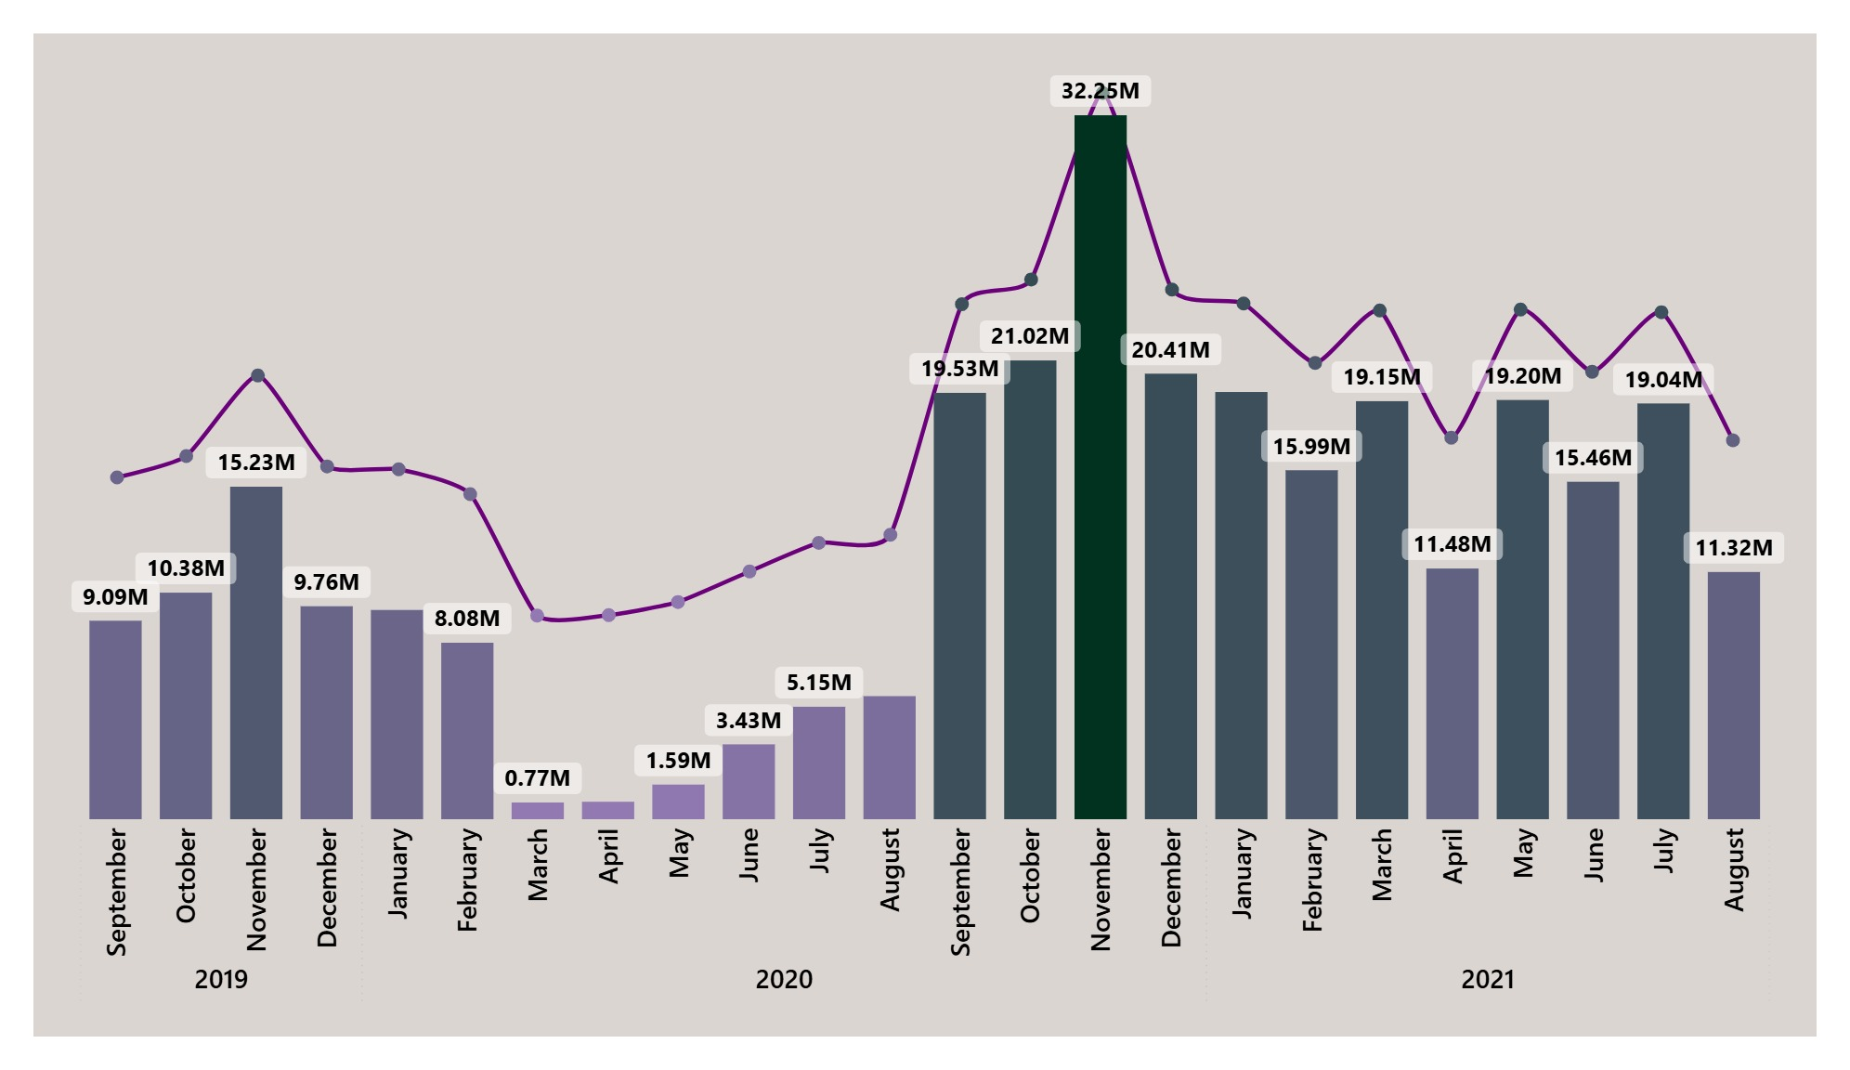
Insights
The spike in September 2020 could be because of seasonal factors such as back-to-school shopping or holiday sales.
The decline in early 2020 might be linked to the COVID-19 pandemic and its impact on economic activity.
The company might have implemented new strategies in 2020 that led to increased sales.
FY 2020
FY 2021

Slide 27
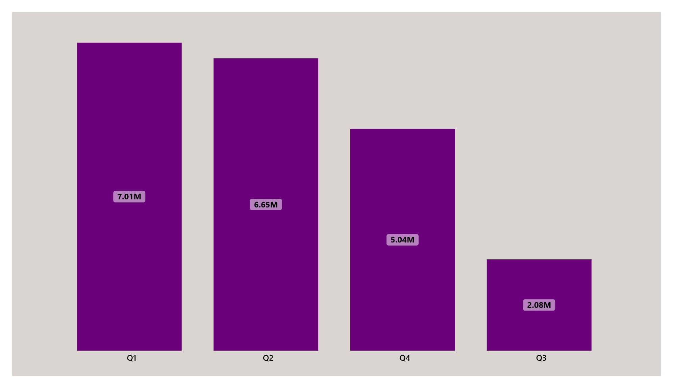
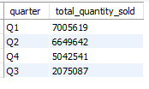
Request 8:
In which quarter of 2020, got the maximum total_sold_quantity? The final output contains these fields sorted by the total_sold_quantity,
Quarter
total_sold_quantity

Slide 28
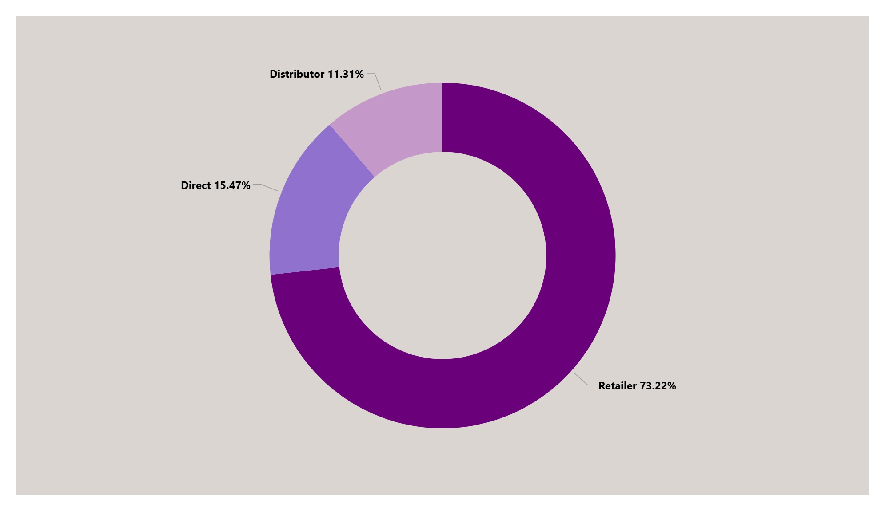
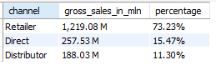
Request 9:
Which channel helped to bring more gross sales in the fiscal year 2021 and the percentage of contribution? The final output contains these fields,
channel
gross_sales_mln
percentage

Slide 29
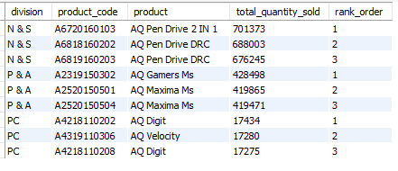
Request 10:
Get the Top 3 products in each division that have a high total_sold_quantity in the fiscal_year 2021? The final output contains these fields,
division
product_code
product
total_sold_quantity
rank_order

Slide 30
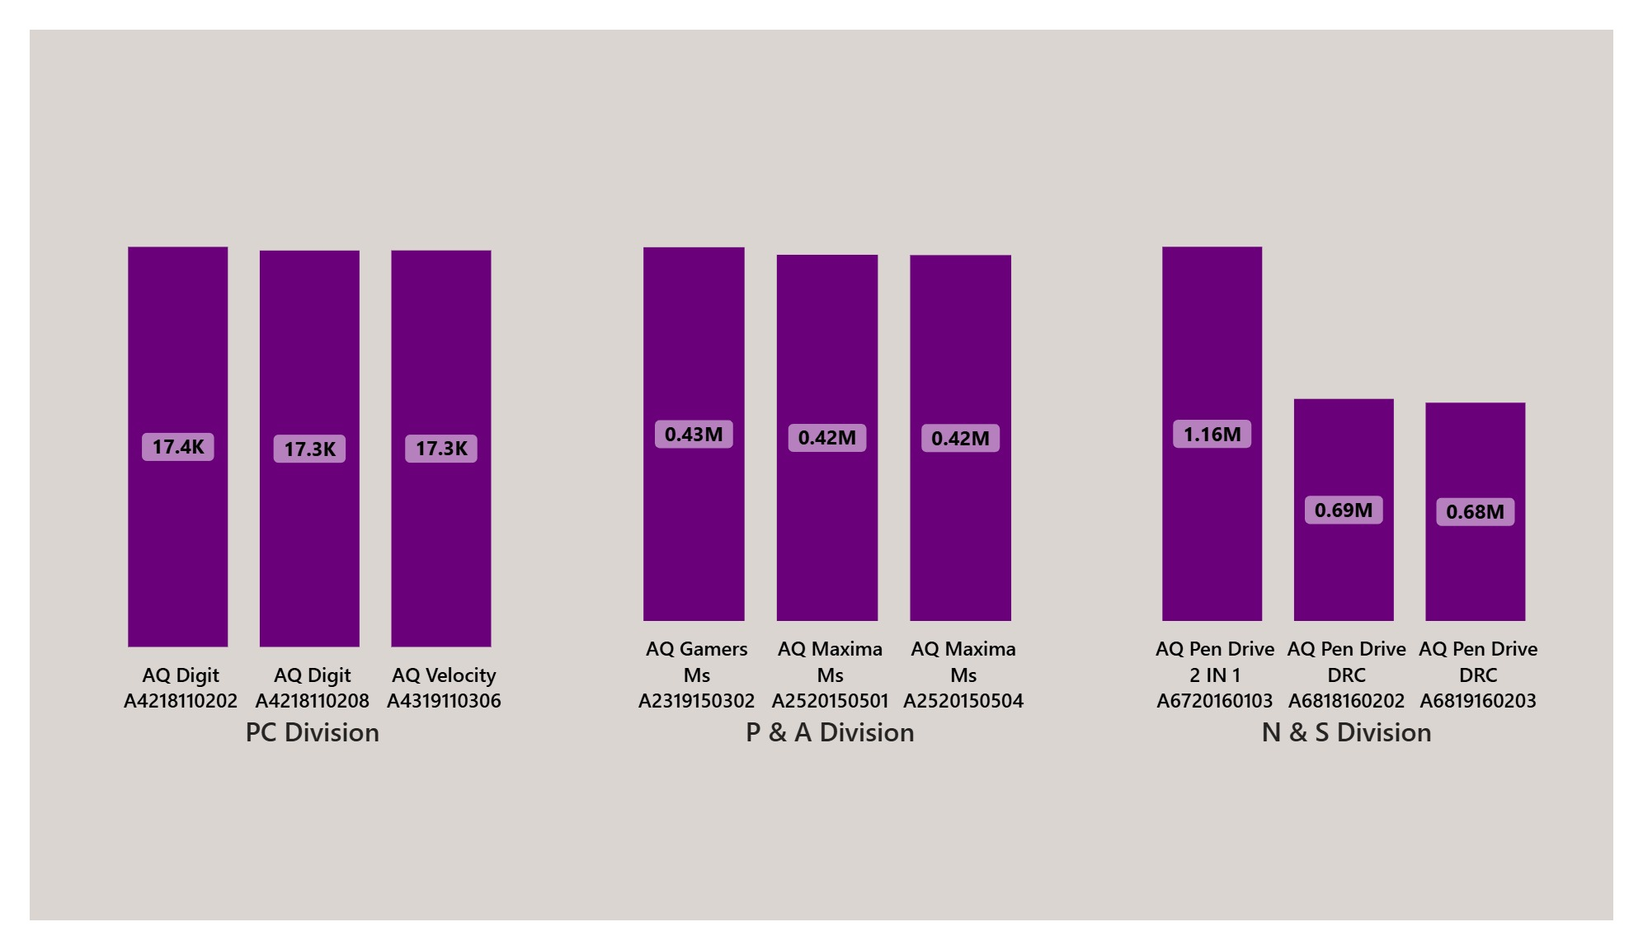
Insights

Slide 31
Feedback

Slide 32
Thank
You

